Slide 1
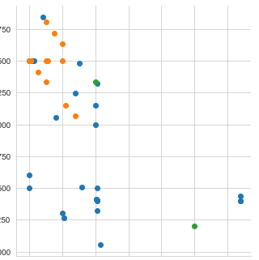
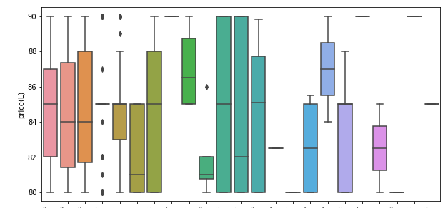
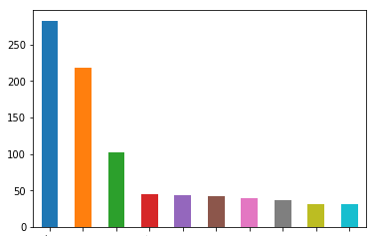
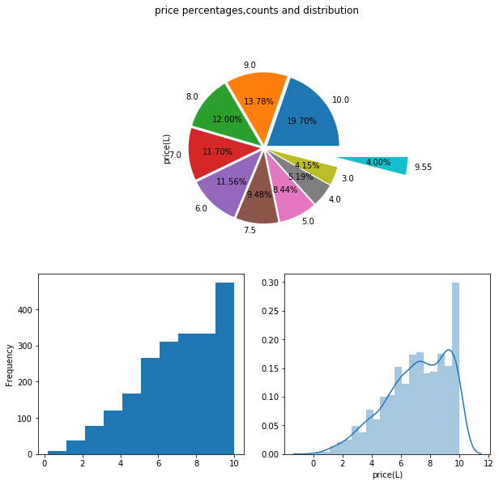
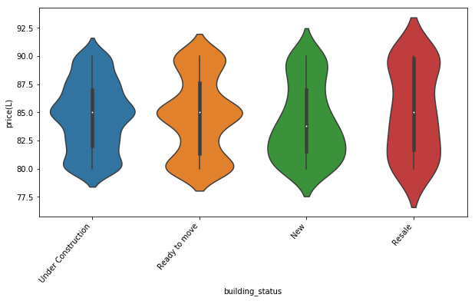

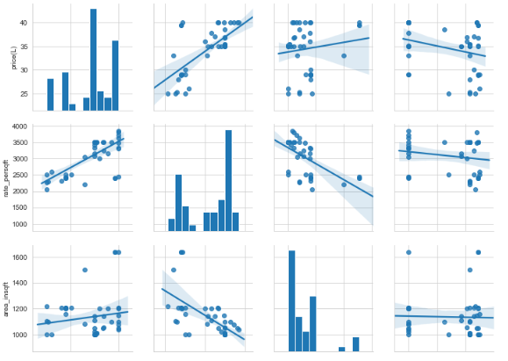
Residential Property Analysis
in
Hyderabad
by
Tejaswi G
B.Tech(IT)
Bhargava Sai P
B.Tech(CSE)

Slide 2
Contents
Introduction
Future Scope
Conclusion
Reason for choosing this project
Project Process
Case Study
Advantages
1
2
3
4
5
6
7

Slide 3

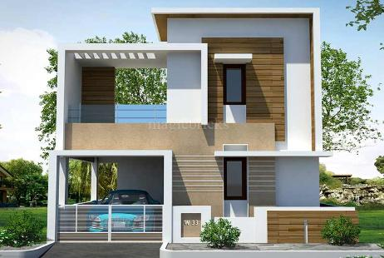
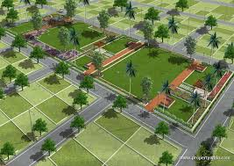

1. Introduction
The project “Residential Property Analysis”, provides various insights on different kinds of residential properties in Hyderabad based on certain attributes.
This Project reduces efforts, saves time in searching and choosing the residential property that suits your needs and requirements.

Slide 4




2. Reason for choosing this project
Basic idea for taking up this project came from our families, who wanted to buy a residential house .
In current generation every one has a dream of having their own Residential property, and thus this thought drove us more into this project which can be more feasible and time saving form of resource for gaining knowledge on residential properties in Hyderabad.

Slide 5

Problem statement
?
Murali P
Requirements
Price : 25 – 40L
Area > 1000sqft
Type : Apartments
(2 or 3 BHK)
Locations :
1. Kukatpally
2. Gachibowli
3. Miyapur
Personal Details
Age : 54
Salary : 14 LPA

Slide 6





3. Project Process
Data Understanding
Data Extraction
Data Cleaning
Data Visualization
Deployment
1
5
2
4
3

Slide 7
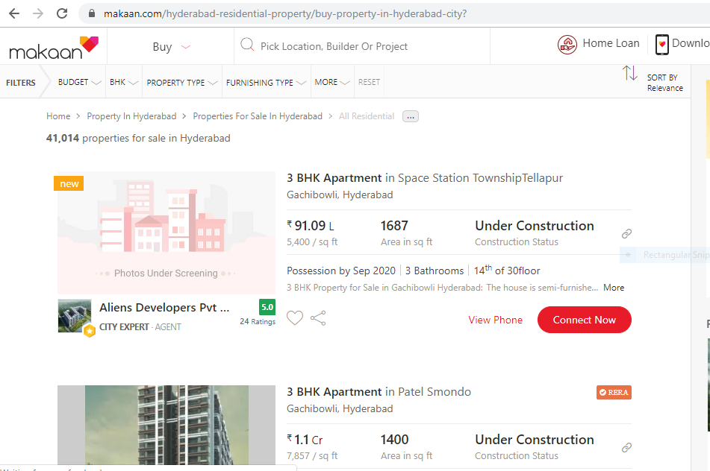
3.1 Data understanding
Website : Property_Analysis (makaan.com/hyderabad-residential-property)
Our features in the data set are title, location, price in lakhs, rate_persqft, area_insqft, building_status, agent_rating.
Title
Location
Price(L)
Rate_persqft
Area_insqf
Building_status
Agent_rating

Slide 8
3.2 Data Extraction
Beautiful Soup :
from bs4 import BeautifulSoup as soup
Dataset :
 | title | location | price(L) | rate_persqft | area_insqft | building_status | agent_rating
0 | Residential Plot | Maheshwaram | 45.00 | 1111 | 4050 | New | 4.6
1 | Residential Plot | Kondakal | 34.00 | 2361 | 1440 | New | 3.7
2 | Residential Plot | Bibinagar | 14.19 | 944 | 1503 | New | 4.9
3 | Residential Plot | Gachibowli | 330.00 | 3333 | 9900 | New | 0.0
4 | Residential Plot | Shadnagar | 6.72 | 466 | 1440 | New | 4.7

Slide 9

3.3 Data Cleaning
 | title | location | price(L) | rate_persqft | area_insqft | building_status
7860 | Residential Plot | Vanasthalipuram | 0.0 | 100 | 450 | New
9992 | Residential Plot | Jubilee Hills | 0.0 | 333 | 150 | New
13947 | Residential Plot | Kukatpally | 0.0 | 213 | 150 | New
14320 | Residential Plot | Nagole Bandlaguda Road | 0.0 | 106 | 150 | New
Before cleaning
(40260, 8)
 | title | location | price(L) | rate_persqft | area_insqft | building_status
7860 | Residential Plot | Vanasthalipuram | 0.45 | 100 | 450 | New
9992 | Residential Plot | Jubilee Hills | 0.50 | 333 | 150 | New
13947 | Residential Plot | Kukatpally | 0.32 | 213 | 150 | New
14320 | Residential Plot | Nagole Bandlaguda Road | 0.16 | 106 | 150 | New
After cleaning
(25715, 7)

Slide 10
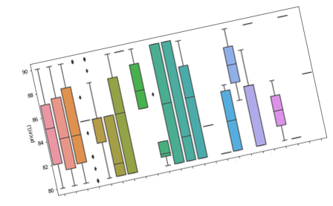
3.4 Data Visualization(EDA)
Exploratory Data Analysis (EDA) is an approach for data analysis that employs a variety of techniques (mostly graphical) to :
maximize insight into a data set
uncover underlying structure
Get to know new assumptions
EDA can be performed by :
Univariate Analysis
Bivariate Analysis
Multivariate Analysis
Libraries:
import matplotlib.pyplot as plt
import seaborn as sns

Slide 11
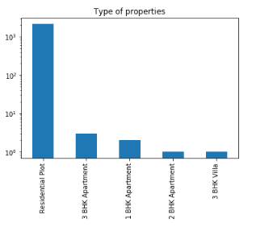
3.4.1 Univariate Analysis
Univariate analysis is the simplest form of analysing data. “Uni” means “one”, so in other words your data has only one variable. It doesn't deal with relationships and it's major purpose is to describe; it takes data, summarizes that data and finds patterns in the data.
Types of plots used for Univariate Analysis:
Histograms
Pie charts
Bar graphs
Density plots
For Example
Bar Graph for types of properties

Slide 12
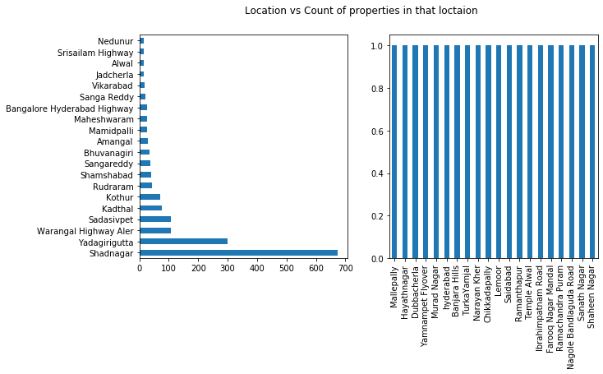
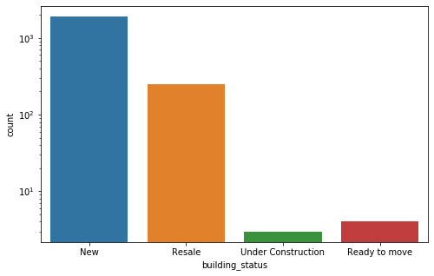

Slide 13
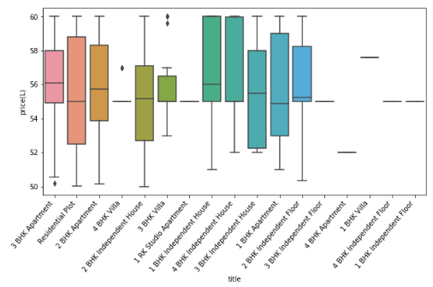
3.4.2 Bivariate Analysis
Bivariate analysis is the simultaneous analysis of two variables (attributes). It explores the concept of relationship between two variables, whether there exists an association and the strength of this association
Types of plots used for Bivariate Analysis:
Box plot
Violin plot
Joint plot
Scatter plot
For Example :
Box plot b/w price and Types of properties

Slide 14
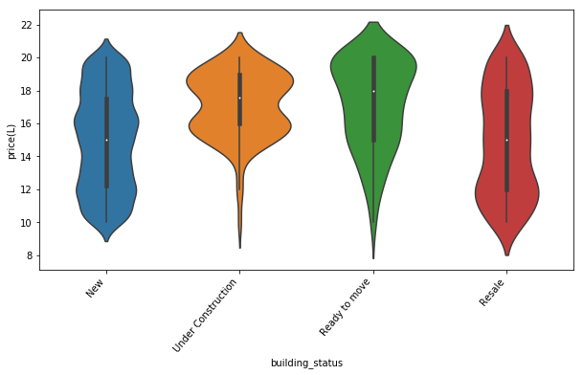
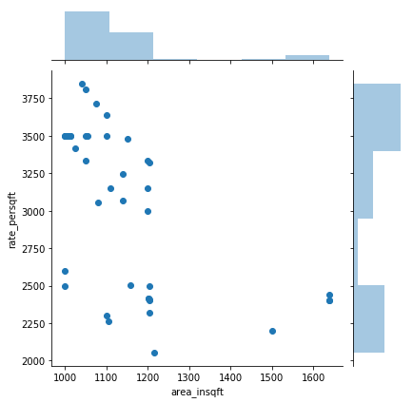
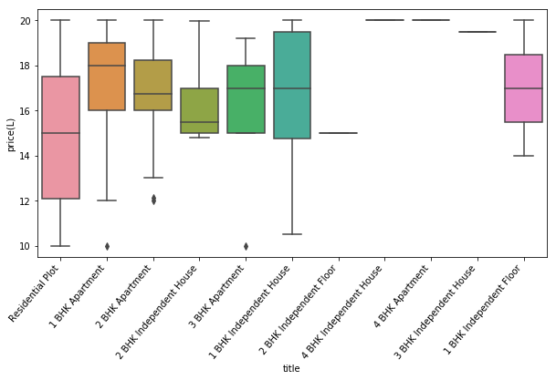

Slide 15

3.4.3 Multivariate Analysis
Multivariate analysis is performed to understand interactions between different fields in the dataset (or) finding interactions between variables more than.
Types of plots used for Multivariate Analysis:
Pair plot
Heat maps
3D scatter plots
For Example :
pair plot btw different attributes

Slide 16
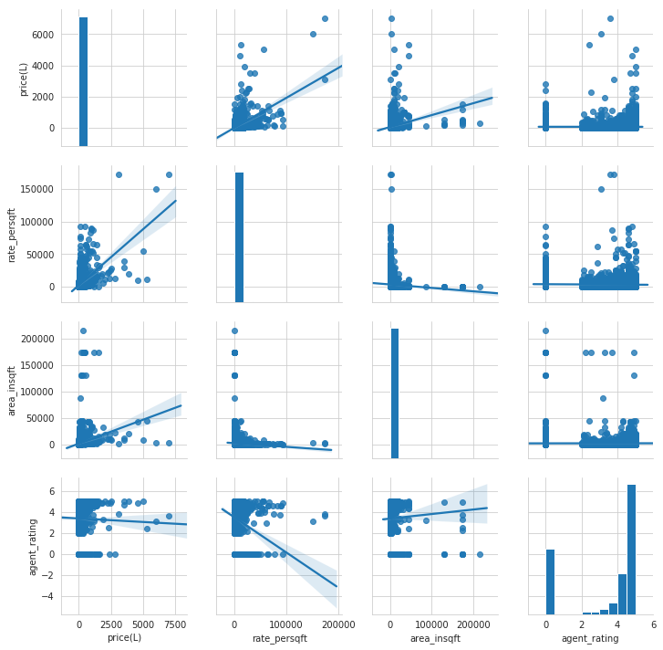
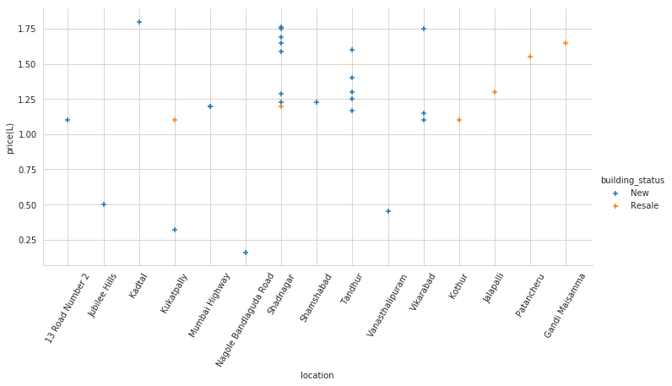
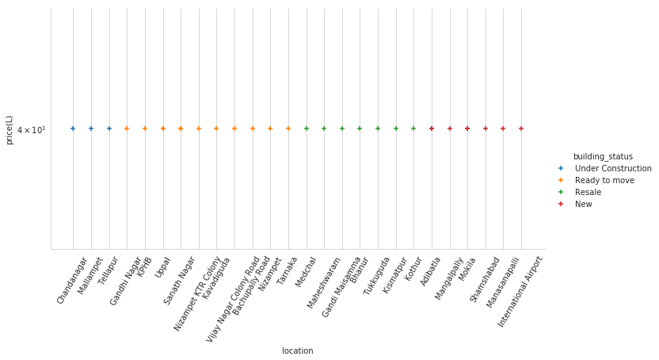

Slide 17
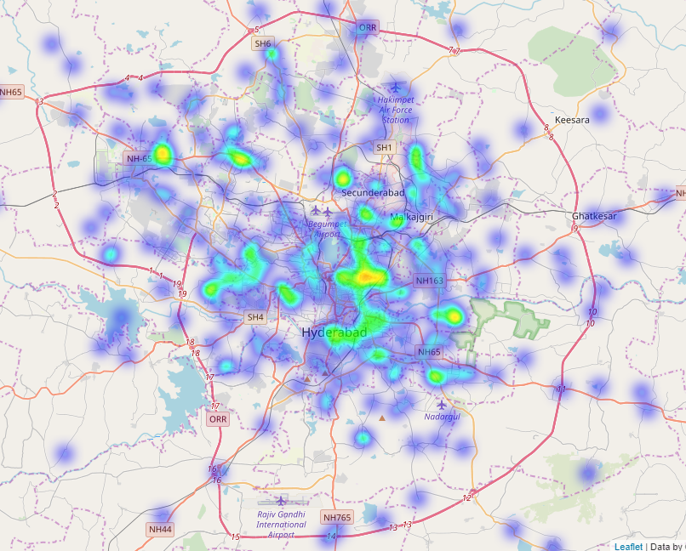

Slide 18
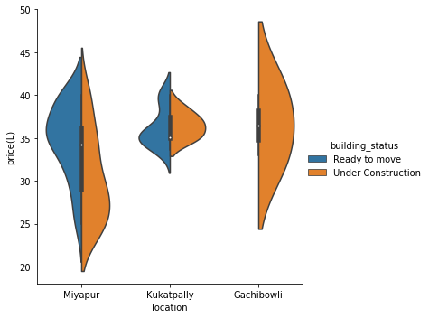
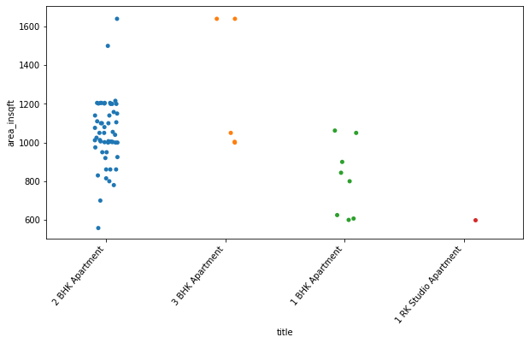
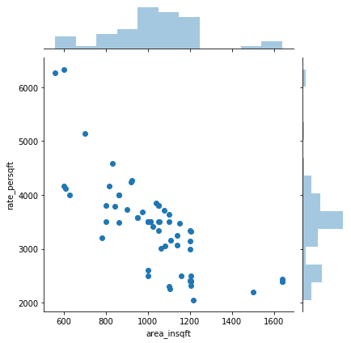
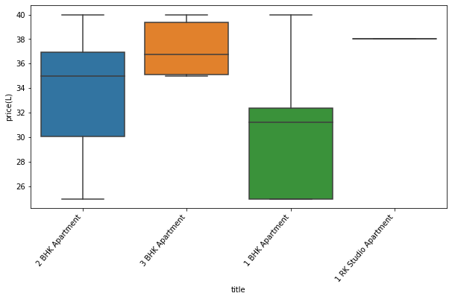
4. Case Study
Requirements:
Price : 25 to 40 L
Area : >1000 sqft
Type : Apartments
(2 or 3 BHK)

Slide 19
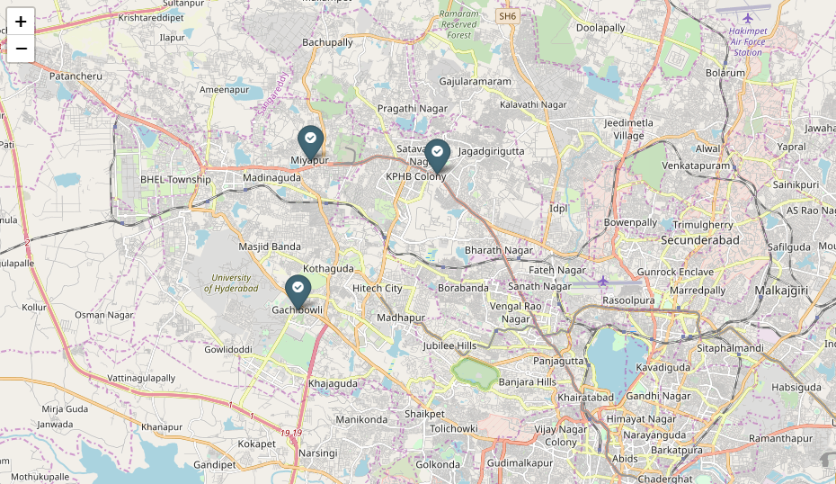

Slide 20

5. Advantages of Project
Reduces efforts and time.
Faster and better.
Good insights on price variations and on other attributes.
Improved Decision making.

Slide 21

6. Future Scope
Feature’s like Address of the property, Agent name and details can be added.
Using locations determine whether the location is within the city or to the outskirts.

Slide 22
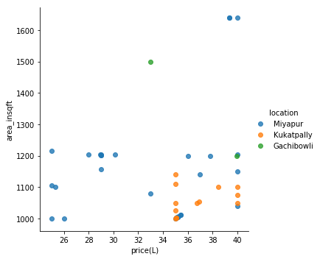

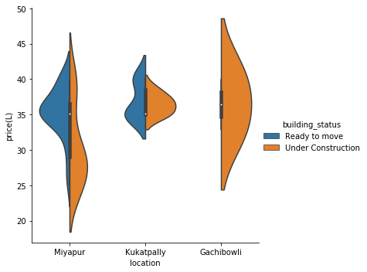
7. Conclusion
In conclusion to the whole of residential properties in Hyderabad there are 14642 residential plots, 8381 Apartments, 979 villa’s, 1558 Independent houses.
In conclusion to case study, 20% of properties have price 40L.
There are different ranges of prices in Miyapur
Finally there are 46 properties that suits to the requirements of client.

Slide 23

8.References
https://seaborn.pydata.org/tutorial/distributions.html
https://towardsdatascience.com/analyze-the-data-through-data-visualization-using-seaborn-255e1cd3948e
https://www.kaggle.com/daveianhickey/how-to-folium-for-maps-heatmaps-time-analysis

Slide 24


Slide 25

Any Queries!
For any further clarifications you can visit to:
https://github.com/Tejaswigilla/Property_Analysis

